Slide 1
Open Source Platform and Network Administration
Lesson 28

Slide 3
Learning Objective and Key Concepts
Learning Objective
Analyze best practices to respond and recover from a security breach (incident).
Key Concepts
Incident response plan
Forensic analysis tools
Compromised system
Backup and recovery process

Slide 4
Regular Performance Audits
Commands
ps
sysstat
strace
top
ldd
lsof

Slide 5
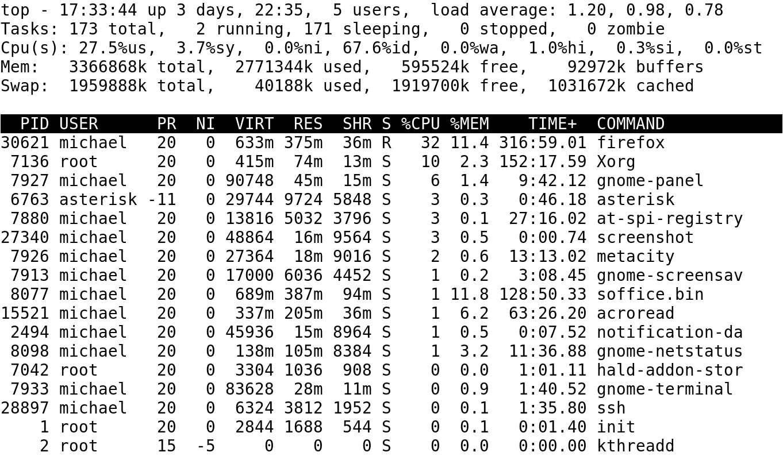
The top Command Provides a View of Active Processes
Notes:
A suspected compromised system cannot be trusted because:
Log files may be deleted.
Typical executables, such as ls and cd, may have been replaced with a black-hat hacker’s version of the executables that may collect passwords.

Slide 6
User Policies
Physical access
Internet access
E-mail access
Remote access
Passwords

Slide 7
Log Access into the Network
Identify users who have logged in
Commands that identify users who are currently logged into a system: w and who
Check system authentication logs
Log files specified in the associated system logging or RSyslog service configuration:
Remote access
Administrative access
Administrative jobs

Slide 8
Incident Response Plan
May be required as part of a regulation
Should be a collaborative effort with various internal teams, such as operations, marketing, public relations, information technology department, and legal department
Should be regularly revisited and updated
Should be strictly adhered to in the event of an incident

Slide 9





Creating an Initial Incident Response Plan
Step 2: The information technology (IT) team quantifies electronic assets on the Linux system.
Step 1: Management collaborates
on defining critical computer systems and resources.
Incident Response Plan
Step 4: A Computer Emergency Response Team (CERT) is created that implements and executes the plan during an incident.
Step 3: IT managers evaluate needed capital and obtain budget approval.

Slide 10
Components of an Incident Response Plan
Action
Investigation
Data recovery and restoration
Communication and reporting

Slide 11
Using a Live CD for Forensics
It mounts the compromised hard drive to collect data in random access memory (RAM).
It copies a bit-by-bit image of the hard drive using the dd command.
It can be used for forensic analysis.
It monitors malicious software activities on the compromised server.
Notes:
A suspected compromised system cannot be trusted because:
Log files may be deleted.
Typical executables, such as ls and cd, may have been replaced with a black-hat hacker’s version of the executables that may collect passwords.

Slide 12
Responding to a Suspected Compromise
Preserve as much evidence as possible.
Immediately notify appropriate people.
Document all actions and findings from the investigative work.
Create an image of the compromised system using the dd command.

Slide 13
Responding to a Suspected Compromise (Continued)
Disconnect from the network, if feasible.
Perform forensic analysis of all evidence.
Restore the computer system back to its original state by using recent backups.

Slide 14
Best Practices for a Backup Plan
Create a backup policy and perform full system backups.
Verify backups.
Periodically perform test restores.
Encrypt confidential data when stored in other media.
Use encryption when backups are performed across a network.

Slide 15
Linux System Administrator
Provides opinion to the management about what constitutes an “incident” on Linux servers
Works in collaboration with other members of the CERT team for creating an incident response plan
Takes appropriate action to minimize further damages on Linux servers when a breach is discovered

Slide 16
Linux System Administrator (Continued)
Notifies appropriate people within the organization during an incident
Provides log files and Linux server access to law enforcement and information security professionals
Obtains backups and restores Linux systems back to production status

Slide 17






Apache Software Foundation (ASF) Incident of April 9, 2010
Ubuntu Server Hosting Jira Web Application
Ubuntu Server Hosting Jira Web Application
Host Attacker
1. There was a cross site scripting (XSS) attack on ASF’s Web application.
4. Root access to the main infrastructure was gained.
2. A software that collected passwords for Web application accounts was installed .
3. One of the compromised accounts on the Web server used the same password on development server. This user had sudo access to ASF’s main infrastructure. Although the user account's password to access the main infrastructure was different, the black-hat hackers were able to find that password cached in one of the account's hidden files.
Notes:
You can read a report on the incident on the following Web link:
https://blogs.apache.org/infra/entry/apache_org_04_09_2010

Slide 18
Summary
Incident response plan
Best practices for responding to a suspected compromise
Role of a Linux system administrator in creating and implementing an incident response plan
ASF incident of April 9, 2010
Advantages of using a live CD

Slide 19
Virtual Lab
Defining Linux OS and Application Backup and Recovery Procedures
Notes:
If your educational institution included the Jones & Bartlett labs as part of the course curriculum, use this script to introduce the lab:
"In this lesson, you examined some of the tools and issues related to the detection of security breaches on a Linux system. You also learned that good security requires the cooperation of users who follow the organization’s security policies. Once a problem has been detected, it’s important to preserve the evidence and document everything. Finally, you discovered the backup and recovery tools used in Linux systems.
In this lab, you will maximize availability and define a recovery time objective (RTO) for data file backups and recovery on a production CentOS Linux server. You will secure a data file backup using OpenSSL encryption and restore the data file from the encrypted backup. You also will recover a deleted file using the /proc recovery function."

